Slide 1

Acid rain and Ozone layer depletion
ENVIRONMENTAL STUDIES
Subject Code : CHM 1002
LECTURE SERIES
By
DR. Abanti Pradhan
Associate Professor
Dept of Chemistry, ITER, Bhubaneswar
SOA [ deemed to be University]

Slide 2
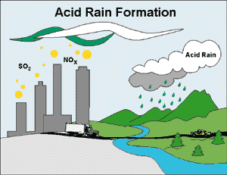
Acid Rain
Acid Rain refers to the deposition of acidic components in either wet or dry forms
“Clean” rain has a natural acidity of about 5.2 on the pH scale due to water reacting with carbon dioxide in the air to form carbonic acid

Slide 3
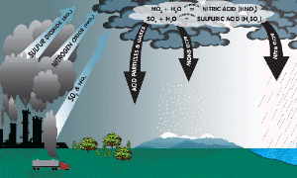
What is Acid Rain
Formed when gases, such as CO_{2,} NO₂ and SO₂ react with the water in the atmosphere
The pH of Rain drops
  As low as pH of 2
  Very harmful to our
  living environment

Slide 4
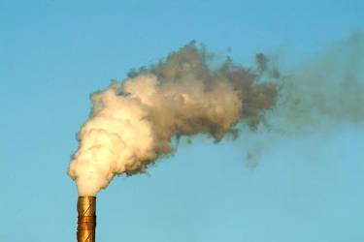
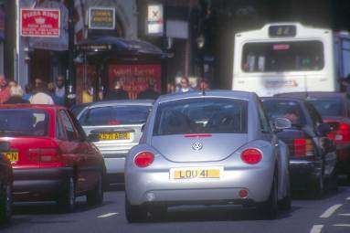
Causes of Acid Rain
Burning coal. Oil and natural gas in power stations makes electricity, giving off sulphur dioxide gas.
Burning petrol and oil in vehicle engines gives off nitrogen oxides as gases.
These gases mix with water vapour and rainwater in the atmosphere producing weak solutions of sulphuric and nitric acids – which fall as acid rain.

Slide 5
Examples
When CO₂ reacts with water, carbonic acid is formed.
CO₂ (g)+H₂O(l)-→H₂CO₃(aq)
When SO₂ reacts with water, sulfurous acid is formed.
SO₂ (g)+H₂O(l)-→H₂SO₃(aq)
When NO₂ reacts with water, nitric acid is formed.
2NO₂(g)+H₂O(l)-→HNO₂(aq)+HNO₃(aq)

Slide 6

How does Acid Rain effect us
It kills micro-organisms
It poisons plants
It damages metals and limestone
It kills fish

Slide 7
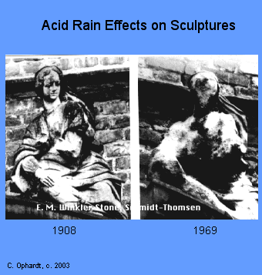
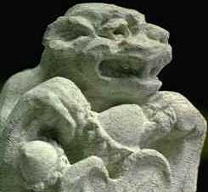
Buildings
Acid rain dissolves the stonework and mortar of buildings (especially those made out of sandstone or limestone).
It reacts with the minerals in the stone to form a powdery substance that can be washed away by rain.

Slide 8
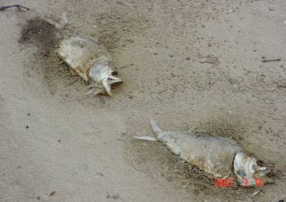
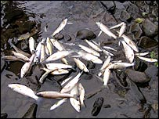
Lakes are also damaged by acid rain. Fish die off, and that removes the main source of food for birds. Acid rain can even kill fish before they are born when the eggs are laid and come into contact with the acid.
Fish usually die only when the acid level of a lake is high; when the acid level is lower, they can become sick, suffer stunted growth, or lose their ability to reproduce.
Also, birds can die from eating "toxic" fish and insects.

Slide 9
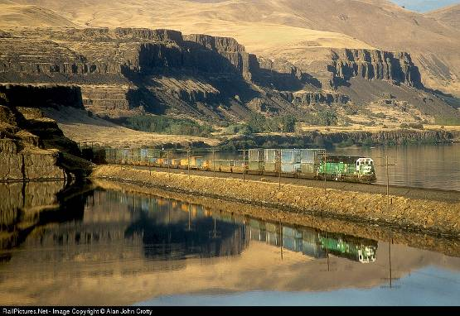
Transport
Currently, both the railway industry and the aeroplane industry are having to spend a lot of money to repair the corrosive damage done by acid rain. Also, bridges have collapsed in the past due to acid rain corrosion.

Slide 10
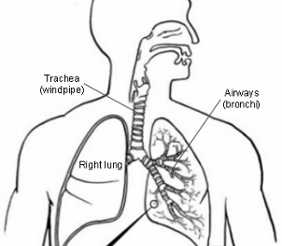
Humans
Humans can become seriously ill, and can even die from the effects of acid rain. One of the major problems that acid rain can cause in a human being is respiratory problems.
Many can find it difficult to breathe, especially people who have asthma. Asthma, along with dry coughs, headaches, and throat irritations can be caused by the sulphur dioxides and nitrogen oxides from acid rain.

Slide 11
Solutions
Sulphur dioxide can be removed from power stations chimneys but this process is expensive.
Reduce the amount of electricity we use
Use renewable energy like wind power, solar panels, tidal power, and geothermal energy.
Fit catalytic converters to vehicle exhausts which remove the nitrogen oxides.
Limit the number of vehicles on the roads and increase public transport.

Slide 12
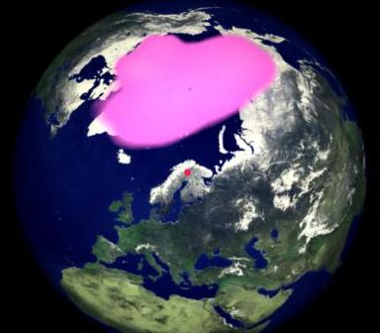
Ozone Layer Depletion

Slide 13
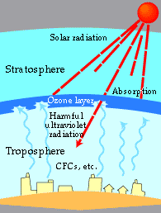
The ozone layer
Ozone is a triatomic form of oxygen (O3) found in Earth’s upper and lower atmosphere.
The ozone layer, situated in the stratosphere about 15 to 30 km above the earth's surface.
Ozone protects living organisms by absorbing harmful ultraviolet radiation (UVB) from the sun.
The ozone layer is being destroyed by CFCs and other substances.
www.epcc.pref.osaka.jp/apec/ eng/earth/ozone_layer_depletion/susumu.html

Slide 14
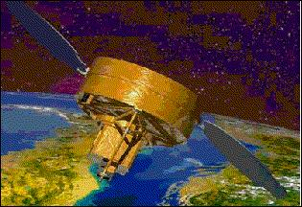
Total Ozone Mapping Spectrometer (TOMS)
Used by NASA to measure ozone concentrations
TOMS – a satellite-borne instrument
TOMS launched in 1996 – makes 35 measurements every 8 seconds
Levels of ozone are measured in Dobson units (DU), where 100 DU is equivalent to a 1 millimeter thick layer of pure ozone
Artist's view of the QuikTOMS spacecraft (image credit: NASA)

Slide 15
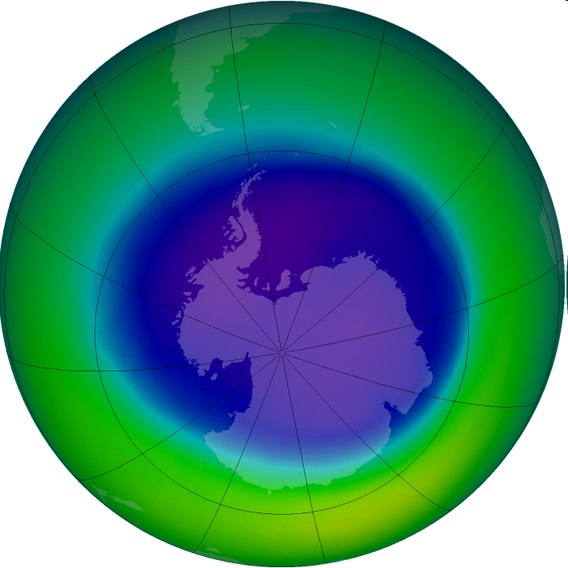

The “Ozone Hole”
  What is the “ozone hole?” When did it first appear? How does it form?
The ozone hole is the region over Antarctica with total ozone 220 Dobson Units or lower. (The avg total column ozone in the atmosphere is about 300 DU.)
The polar vortex formed over Antarctica is very tight and the reaction occurring on the surface of the cloud crystals is far different from when it occurs in atmosphere. These conditions have led to ozone hole formation in Antarctica.
Ozone hole in Sept 2005. Source: NASA

Slide 16
What is CFCs?
Chlorofluorocarbons (CFCs)
Composed of elements chlorine, fluorine, and carbon
CFCs were welcomed by industries:
  Low toxicity
  Chemical stability
  Cheap
Usage:
  As refrigerants
  As cleaning agents
  As propellants

Slide 17
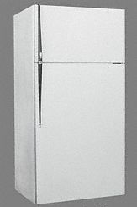
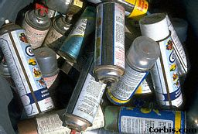
What is CFCs?
CFCs are used in aerosol sprays (Sources: http://www.yahoo.com)
CFCs were used as refrigerants in the past (Sources: http://www.yahoo.com )

Slide 18
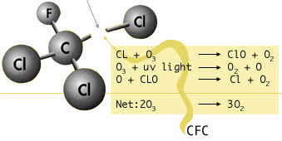
Chemical Mechanism
Different chemicals are responsible for the destruction of the ozone layer
Topping the list :
  chlorofluorocarbons (CFC’s)
  In the stratosphere, Ozone are photolysed, releasing reactive chlorine atoms that catalytically destroy ozone

Slide 19
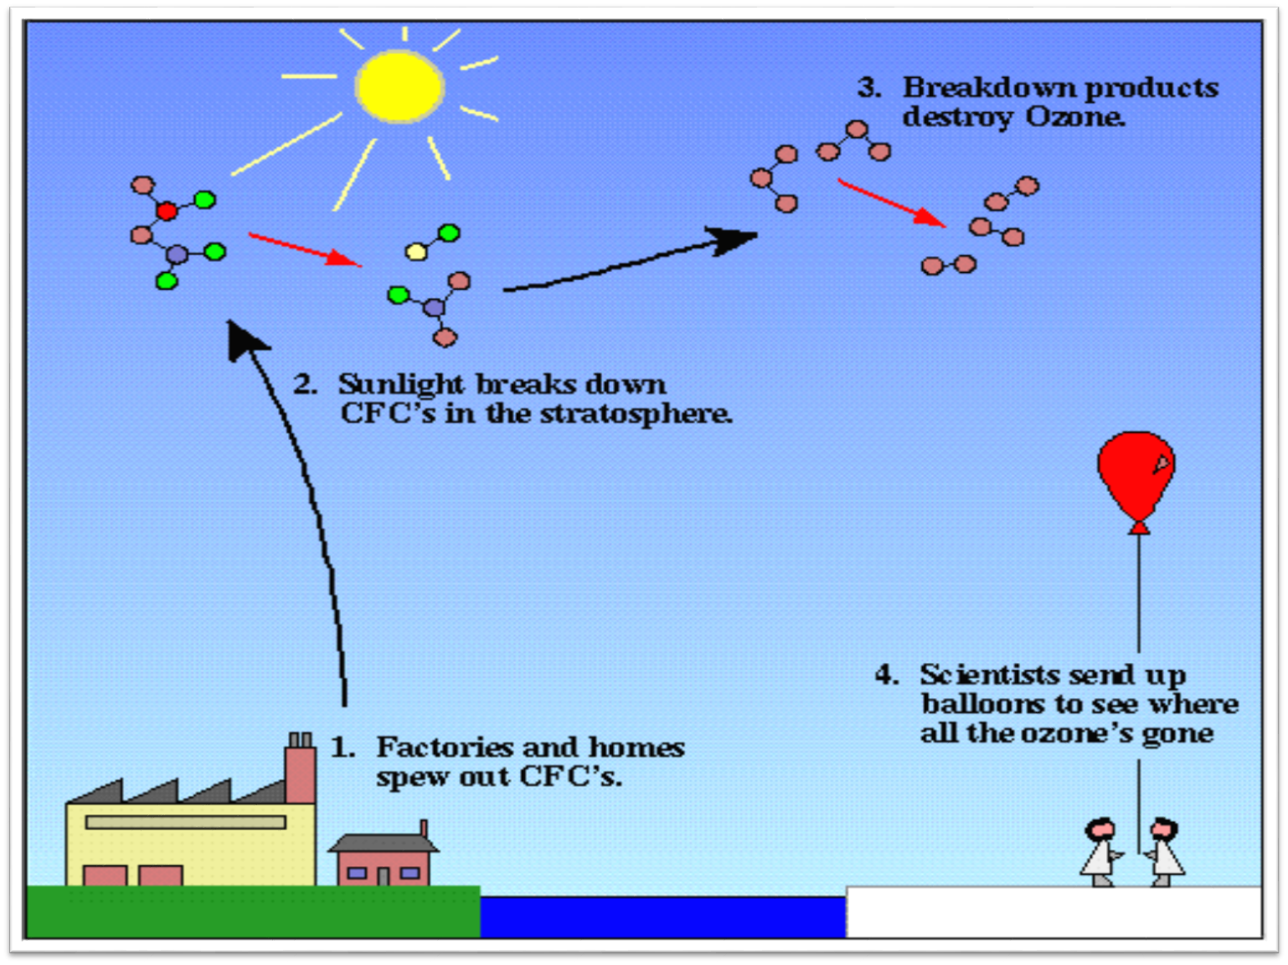
Chlorine atoms from CFCs attack the ozone, taking away ozone and forming chlorine monoxide (ClO).
O₃ + Cl → O₂ + ClO
Chlorine monoxide then combines with another oxygen atom to form a new oxygen molecule and a chlorine atom.
ClO + O → Cl + O₂
The chlorine atom is free to destroy up to 100,000 ozone molecules

Slide 20
The Chapman Cycle
1930
  Sydney Chapman proposed a series of reactions to account for the ozone layer: the Chapman Cycle
  The Chapman Cycle explains how the ozone layer is formed and maintained. Describe this process in some detail.
  Four chemical reactions
    Initiation O₂ + light → 2O (120 – 210 nm)
    Propagation (cycling)
    O + O₂ + M → O₃ + M* (generates heat)
    O₃ + light → O₂ + O (220 – 320 nm)
    Termination O₃ + O → 2O₂

Slide 21
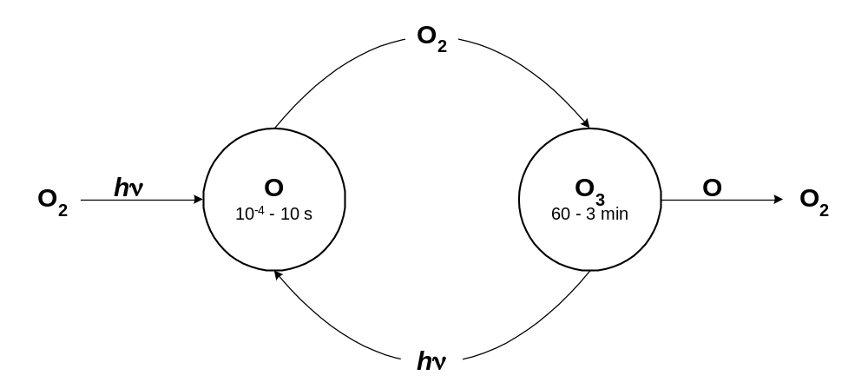
The Chapman Cycle
“odd-oxygen” species (O_{x}) are rapidly interconverted
O_{x} = O + O₃
Notes:
Give the four Chapman reactions:
O₂ + hv → 2O (< 242nm)
O + O₂ + M → O₃ + M* (generates heat)
O₃ + hv → O₂ + O(¹D) (usually followed by rapid deactivation to ³P)
O + O₃ → 2O₂
Need to talk about the time frames of the reactions. In one cc, typical rates for the four reactions are:
10⁶ molecules of O₂ photodissociate per second
10⁵ molecules of O₃ react with O per second
10⁸-10⁹ “cycles” of O_{x} conversions occur per second
Thus, the typical “chain length” of the cycles is about 1000. In other words, the rate of interconversion among O_{x} species is (very roughly) one thousand times faster than the rate of O_{x} production or loss.

Slide 22
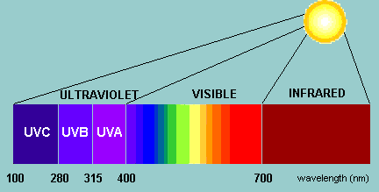
Stratospheric Ozone and Ultraviolet Radiation (UVR)
Ultra-violet radiation (UVR) high energy electromagnetic wave emitted from the sun. It is made up of wavelengths ranging from 100nm to 400nm.
UV radiation includes UV-A, the least dangerous form of UV radiation, with a wavelength range between 315nm to 400nm, UV-B with a wavelength range between 280nm to 315nm, and UV-C which is the most dangerous between 100nm to 280nm. UV-C is unable to reach Earth’s surface due to stratospheric ozone’s ability to absorb it. (Last, 2006)

Slide 23
Too much ultra-violet light can result in:
Skin cancer
Eye damage such as cataracts
Immune system damage
Reduction in phytoplankton
Damage to the DNA in various life-forms

Slide 24
Effects of UV radiation on biological organisms
DNA damage ………………………….. Maximum effect on small and single cell organisms
Impaired growth and photosynthesis ...poor crop yields
Phytoplankton: ………………………...Reduced uptake of CO2
…………………………………………..mortality
…………………………………………..Impaired reproductive capacity
Nitrogen-fixing soil bacteria…………. Reduced, damaged
Human health effects:
Suppressed immune system……………..Enhanced susceptibility to infection
…………………………………………..Increase risk of Cancer
Dermatology (skin)……………………...Sunburn
…………….………………………….....Loss of skin elasticity (Premature aging)
…………….…………………………… Photosensitivity
Neoplasia (cancer)……………………....Melanocytic (malignant melanoma)
…………….………………………….....Squamous cell skin – cancer
…………….……………………………Basal skin – cancer
Still questionable if causes lip cancer or cancer of
the salivary glands
Oculur (Eye)….…………………….......Cataract
…………….…………………………....Pterygium
(last, 1993)

Slide 25
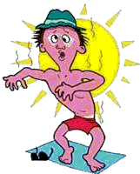

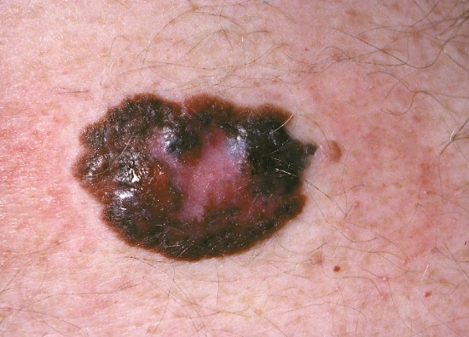
Effects on Human Health
Over exposure may:
  Increase risk of sun burn and skin cancer
malignant
www.ldeo.columbia.edu/.../ lectures/ozone_health/

Slide 26
Over Exposure
  Suppress immune system
  Accelerate aging of skin due high exposure
  Cause an outbreak of rash in fair skinned people due to photo allergy – can be severe
dermis.multimedica.de/.../ en/13007/image.htm

Slide 27
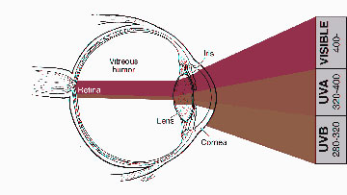
Over Exposure to UV-B….
Increases the risk of cataracts Leading to blindness
vitreous humor
then the lens
cornea is encountered first
www.ldeo.columbia.edu/.../ lectures/ozone_health

Slide 28
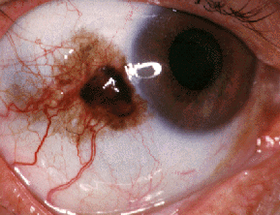
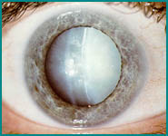
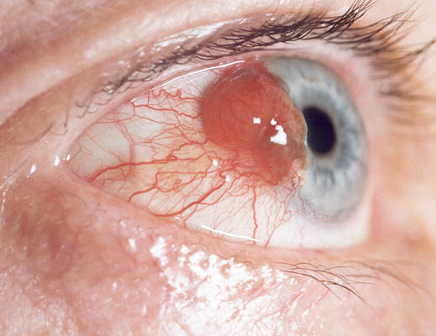
Manifestations of…
Cancer
Cataracts
brought on by over exposure to UV-B

Slide 29
What Is Being Done to Counter the Effects of Ozone Depletion?
Montreal Protocol (adopted in 1987) – panel of experts was formed to investigate substances responsible for hole formation
  Established policies that prevent future use of certain types of chemicals
  Stipulated that the production and consumption of compounds contributing towards depletion of ozone in the stratosphere were to be phased out by the year 2000

